Slide 1
Web Scraping with R
Heather Lendway

Slide 2
What is web scraping?
Technique used for extracting data from websites
Fetch a page, parse content, wrangle and aggregate data
Save data to database or spreadsheet
Typically done in an automated fashion
Reference:
https://en.wikipedia.org/wiki/Web_scraping

Slide 3
Why web scraping?
Create a workable dataset
Table(s) on a webpage
Multiple result pages
Sporadic locations throughout the page
Ability to schedule/automate pulling fresh data
Refresh data/analysis
Loop over result sets for different user inputs

Slide 4
Tools for accessing data on the web
Use a website API
Comprehensive list of available APIs
Read and parse html and/or json programmatically
Download the “SelectorGadget” chrome extension
Get comfortable with Developer Tools to dive into html and request strings.
Note when using APIs or screen scaping software packages, there may be limits to the number of calls you can make or bot detectors that will stop your requests. You may need to add Sys.sleep(1) calls to your R code.

Slide 5
Example with Glassdoor, R and rvest
Goal:
Collect a list of companies in a given city
Compile a data set of reviews and ratings for companies in the city

Slide 6


Slide 7
Steps to get data:
Create a URL to view the list of companies given a city
Create a URL to view the review page for a given company
Compile the review data for each company
Date, Summary, Job Title, Location, Recommends, Outlook, CEO Rating, Experience, Pros/Cons, Advice to Management
Compile code to loop through and pull all results

Slide 8
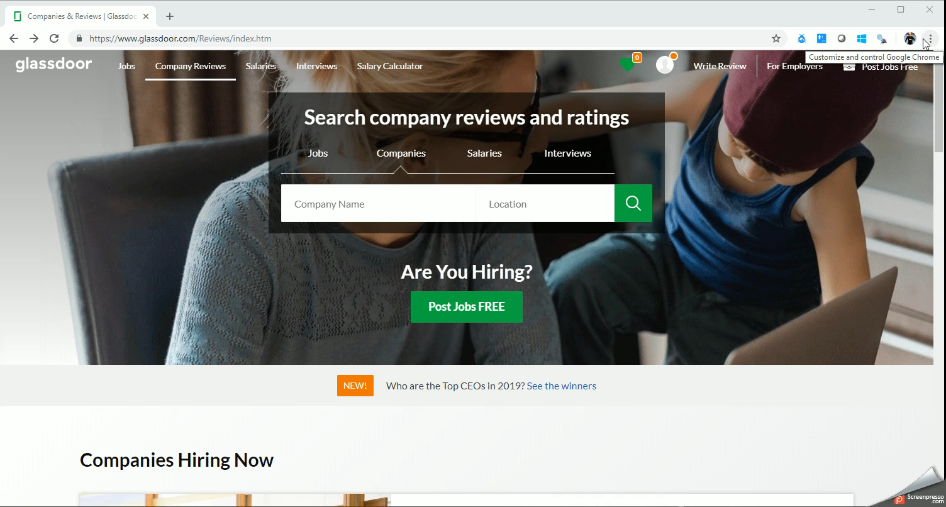
1. Create a URL to get company results

Slide 9
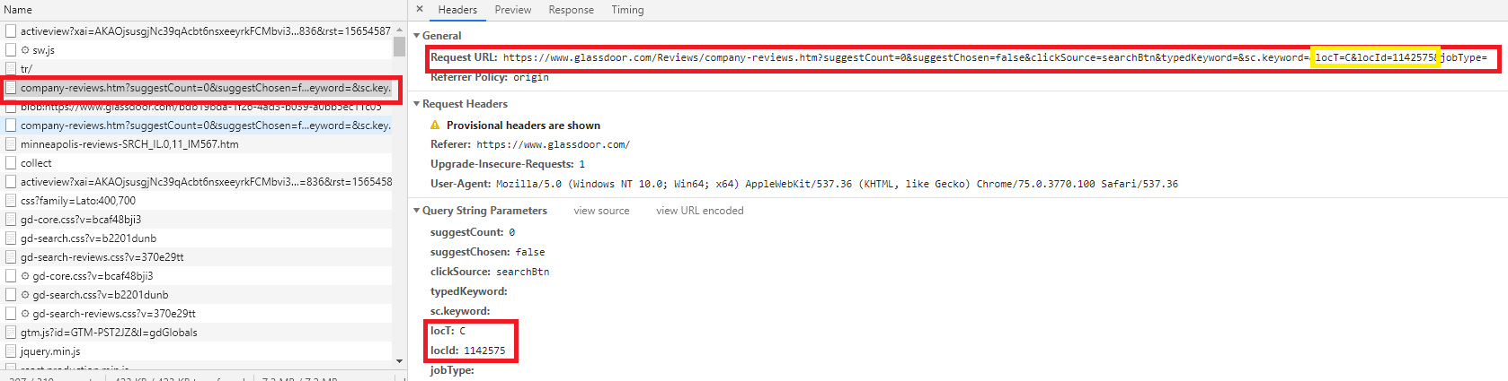
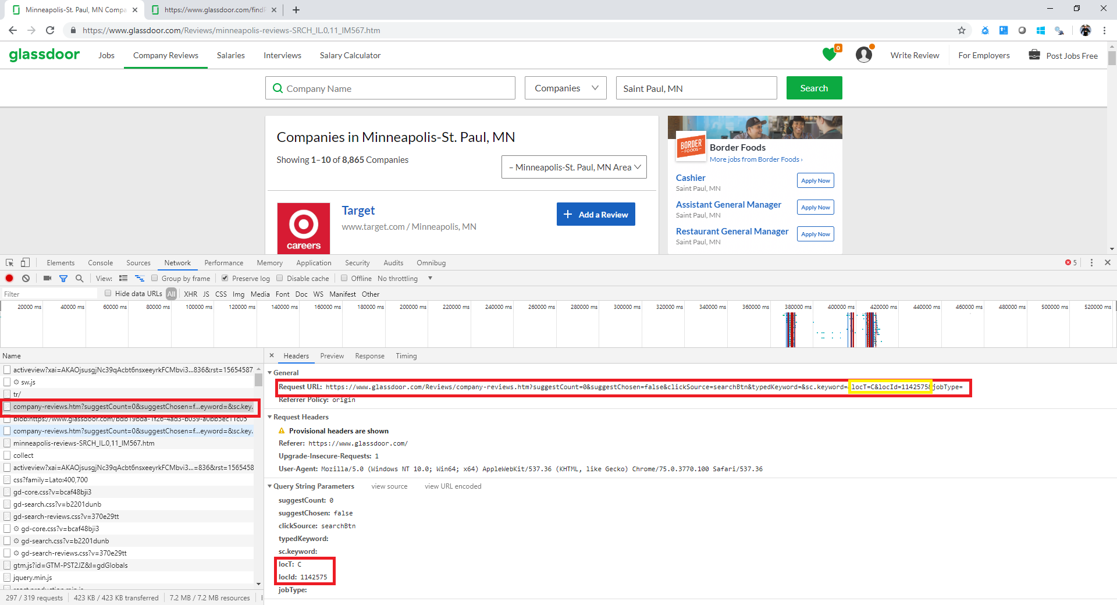
1. Create a URL to get company results
Request URL for Saint Paul: https://www.glassdoor.com/Reviews/company-reviews.htm?suggestCount=0&suggestChosen=false&clickSource=searchBtn&typedKeyword=&sc.keyword=&locT=C&locId=1142575&jobType=
Query String Parameters:
locT
lotId

Slide 10
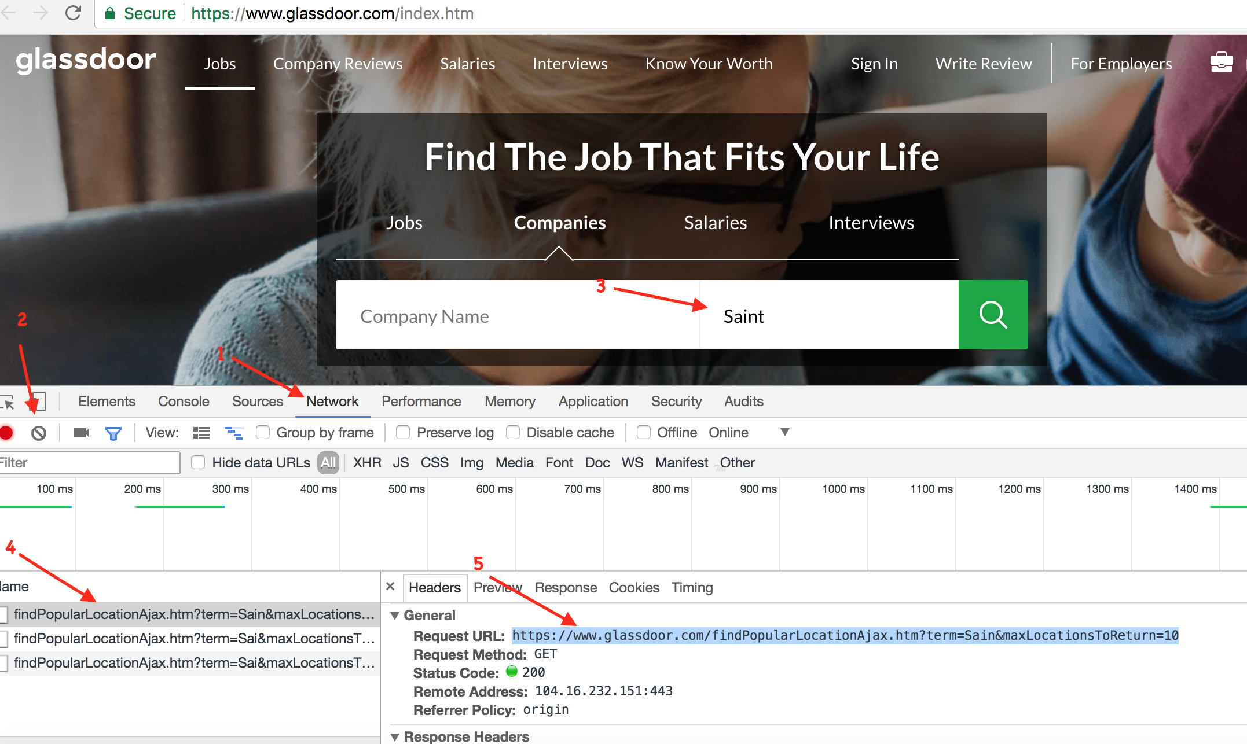
Create a URL to get company results (cont.)
https://www.glassdoor.com/Reviews/index.htm
Open developer tools and go to the “Network Tab”
Start typing your search city and URL’s will appear under the “Name” list
Click on the link under “Name” with the city listed under term to see the Request URL pop up in an additional panel.
This JSON gives us the parameter for our request URL

Slide 11
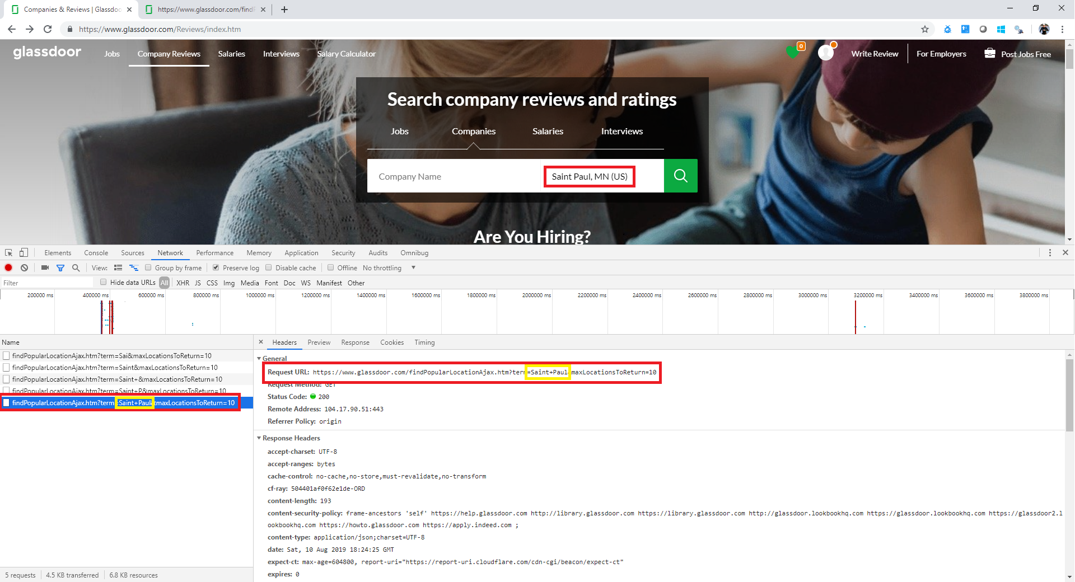
1. Create a URL to get company results (cont.)
Request URL to get search city JSON:
https://www.glassdoor.com/findPopularLocationAjax.htm?term=Saint+Paul&maxLocationsToReturn=10
JSON results give us query string parameters for company request URL:
locT: “loactionId”= 1142575
locId: “locationType”= “C”
Query string parameters for city JSON:
term: city you’re searching for
Replace any “ ” with “+”

Slide 12
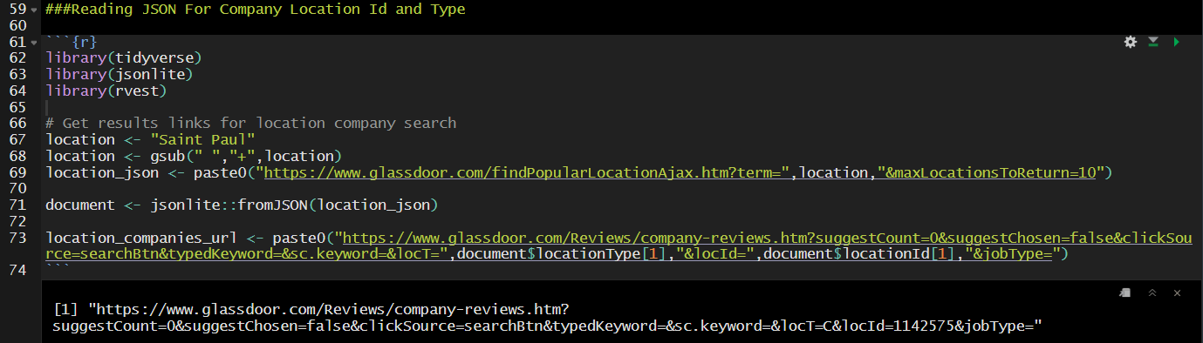
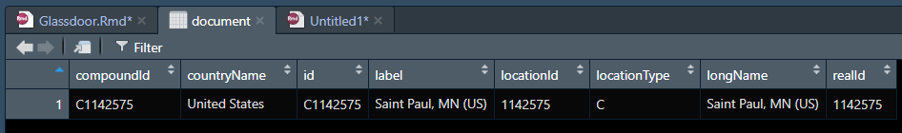
1. Create a URL to get company results (cont.)

Slide 13
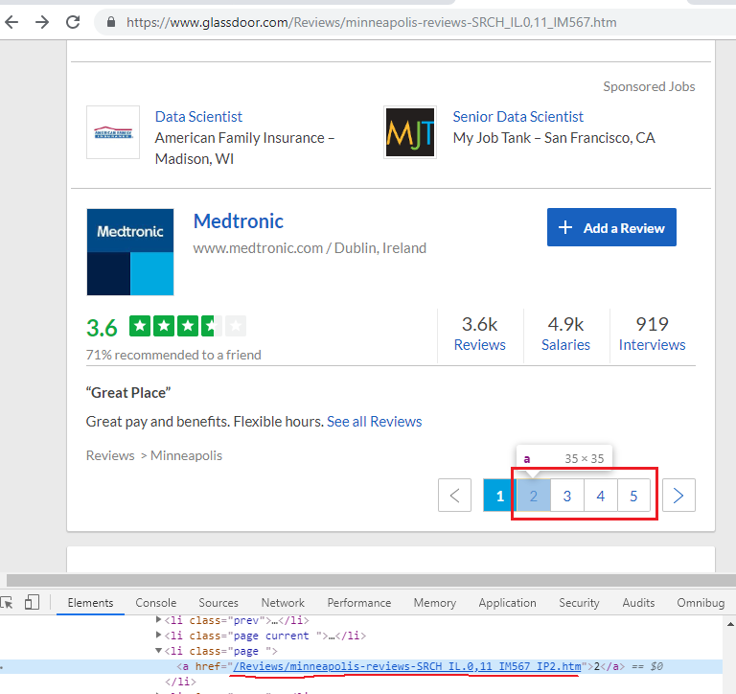
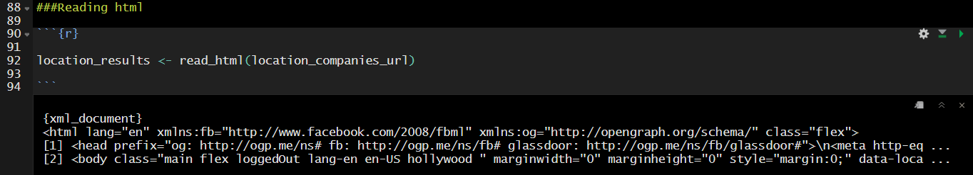
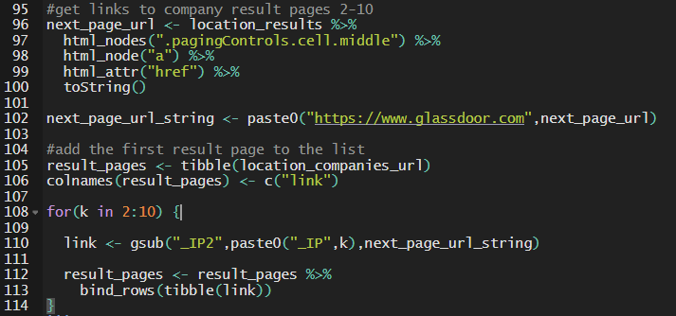
1. Create a URL to get company results (cont.)
Read html for the company result page
Get all result pages (limited to 10)

Slide 14
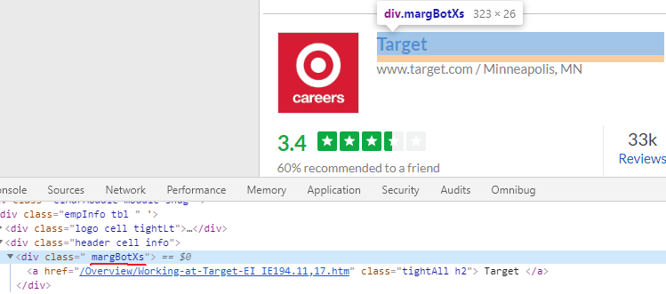
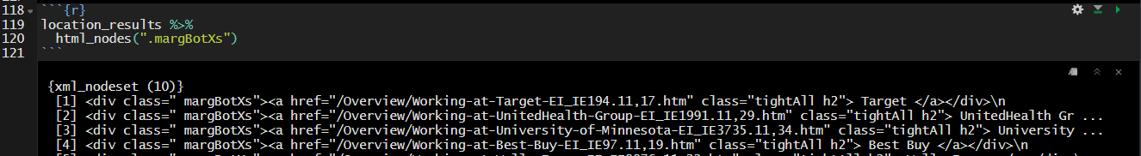
Accessing data from xml doc with rvest
html_node() / html_nodes() – pull the first node meeting the criteria or entire nodeset
Grab nodes by class name using html_nodes(“.class_name”)
Grab notes by tag name using html_nodes(“div”)
Grab by both tag and class using html_nodes(“div.class_name”)
Grab multiple tags and classes using html_nodes(“div.class_one_name,div.class_two_name”)
For class names with spaces, replace the space with a “.”, i.e. class=“pretty text”
html_nodes(“.pretty.text”)
For multiple child nodes you can use :nth-child(#)
html_nodes(“.class_name:nth-child(3)”)
Sample output:

Slide 15
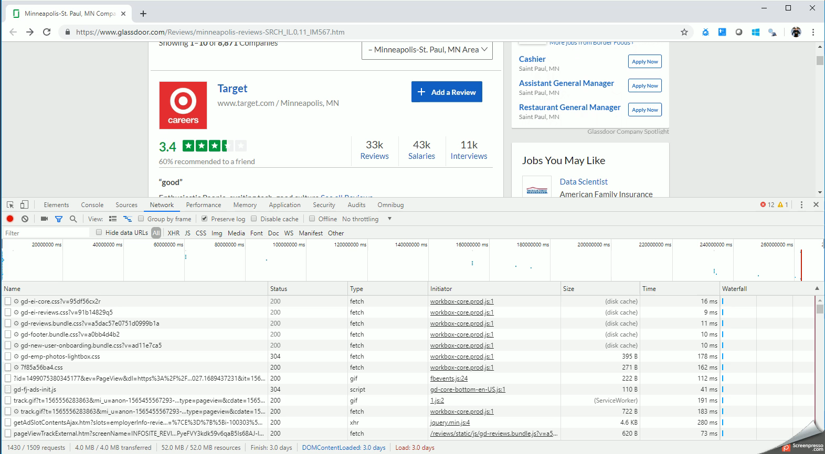
2. Create a URL for the review page

Slide 16
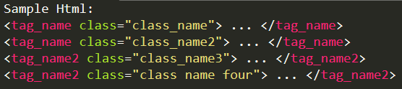
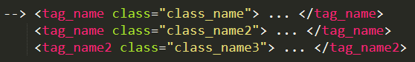
Parsing HTML with rvest
html_node() #Pull the first node that meets the critera
html_nodes() #Pull the entire nodeset that meets the criteria
Use CSS Selectors

Slide 17
Parsing HTML with rvest (cont.)

Slide 18
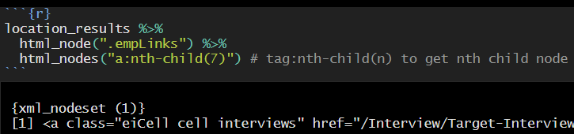
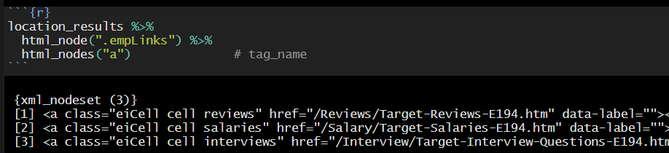
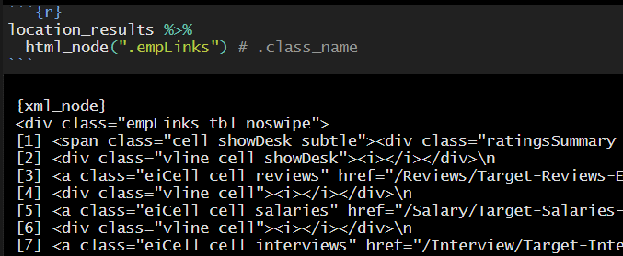
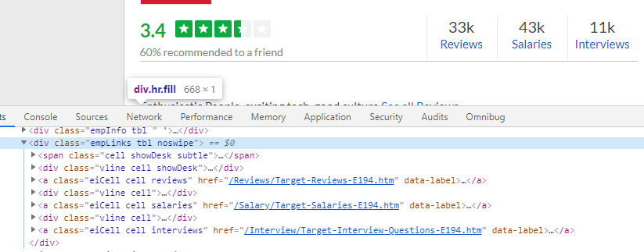
Parsing HTML with rvest
html_node() #Pull the first node that meets the critera
html_nodes() #Pull the entire nodeset that meets the criteria
Use CSS Selectors
class name, tag name or combos

Slide 19
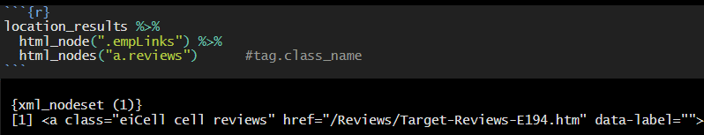
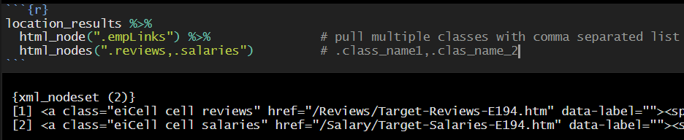
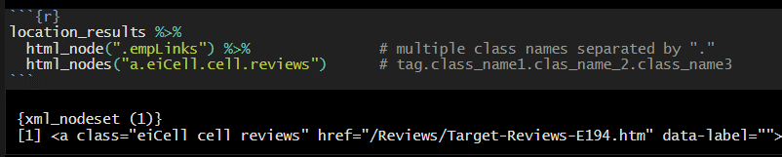
Parsing HTML with rvest (cont.)

Slide 20
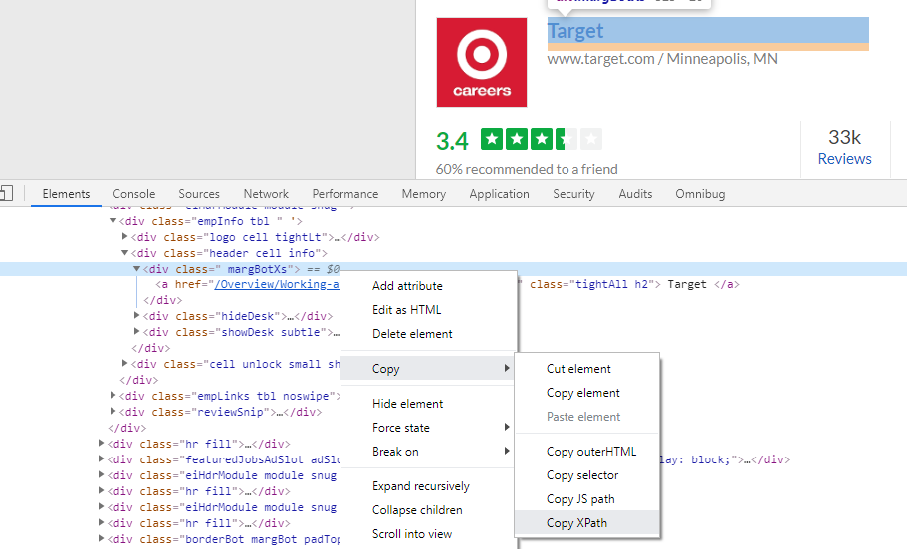
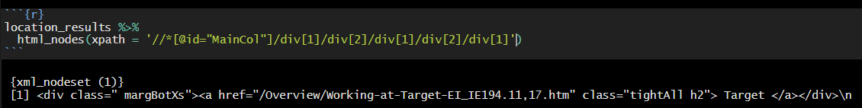
Parsing HTML with rvest (cont.)
Grab the nodes by xpath
Right click the html in developer tools
Mouse over Copy
Select `Copy Xpath`
Helpful when you want a very specific node

Slide 21
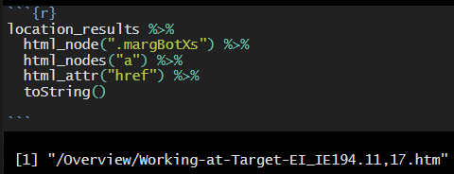
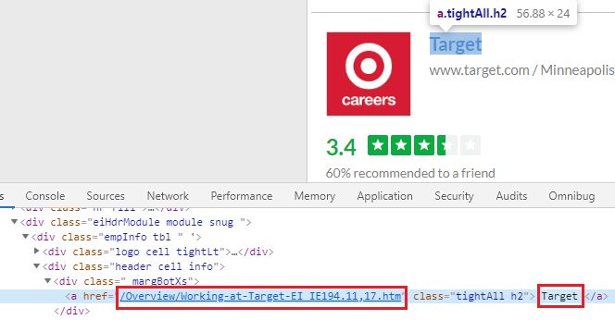
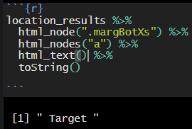
Parsing HTML with rvest (cont.)
Use html_attr() to grab value of a specific node attribute
Use html_text() to grab the value of the tag

Slide 22
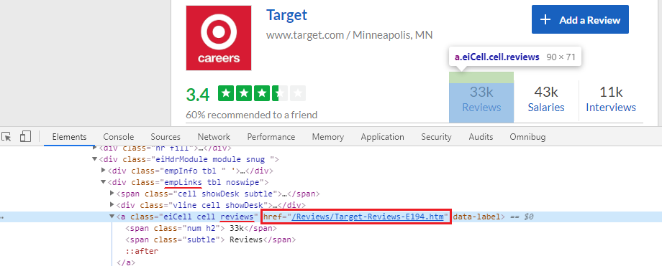
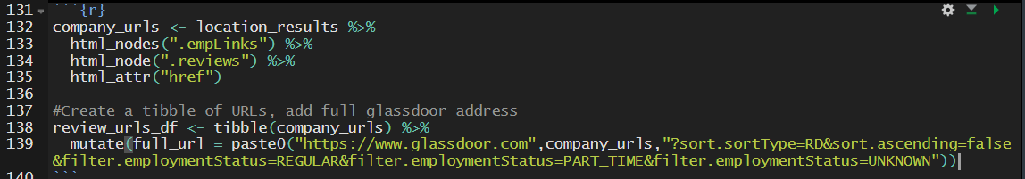
2. Create a URL for the review page (cont.)

Slide 23
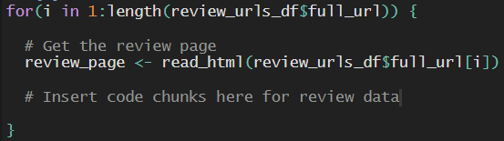
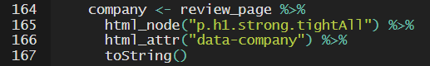
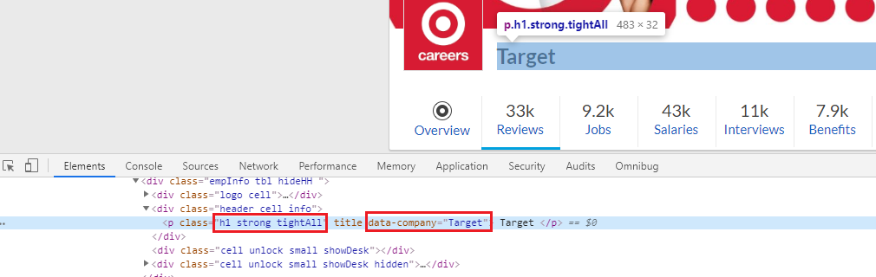
3. Compile the review data for each company
Add code chunks to a loop that pulls the data from each review page
Get the company name:

Slide 24
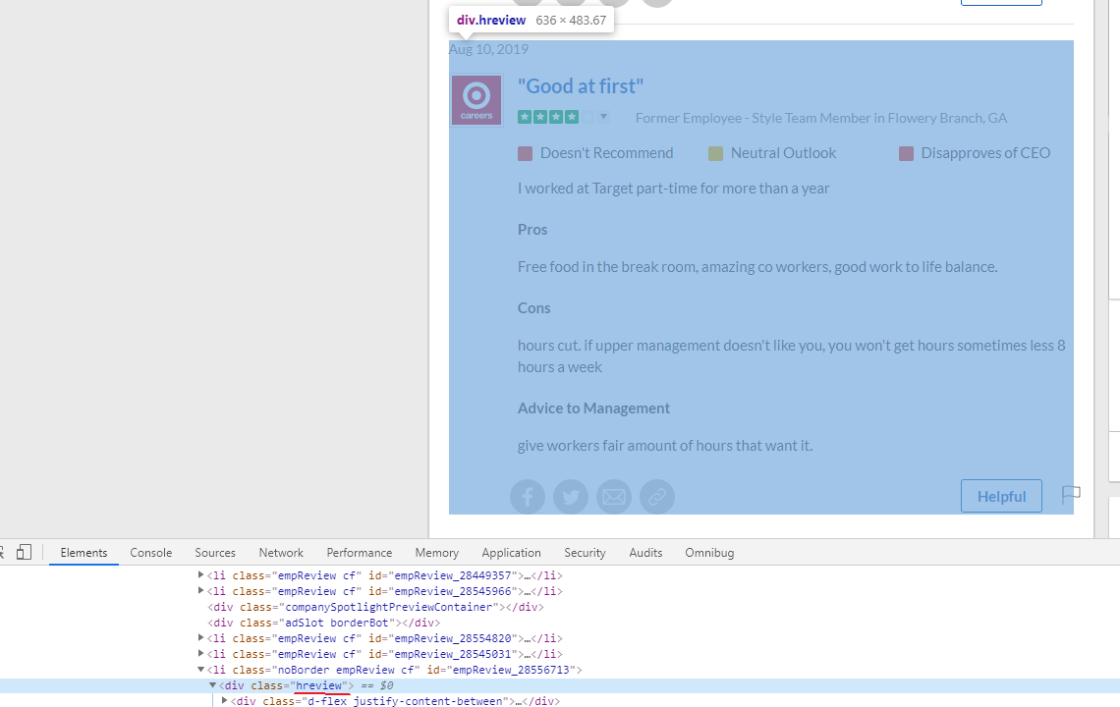
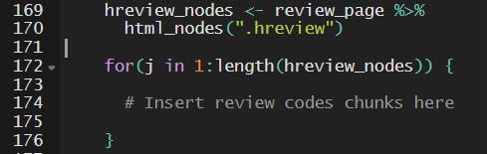
3. Compile the review data for each company (cont.)
Get the review nodes and loop through to grab each data point.

Slide 25
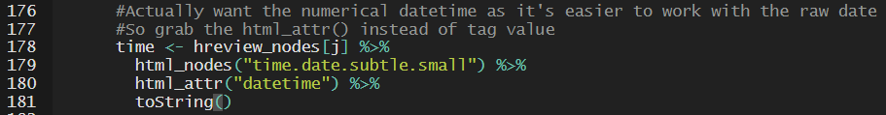
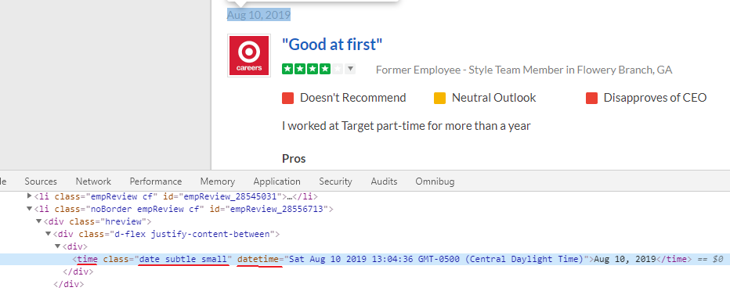
3. Compile the review data for each company (cont.)
Get the datetime:

Slide 26
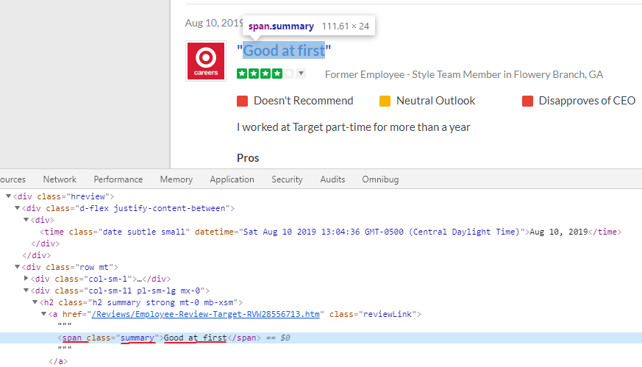
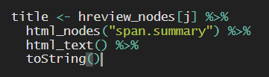
3. Compile the review data for each company (cont.)
Get the review title:

Slide 27
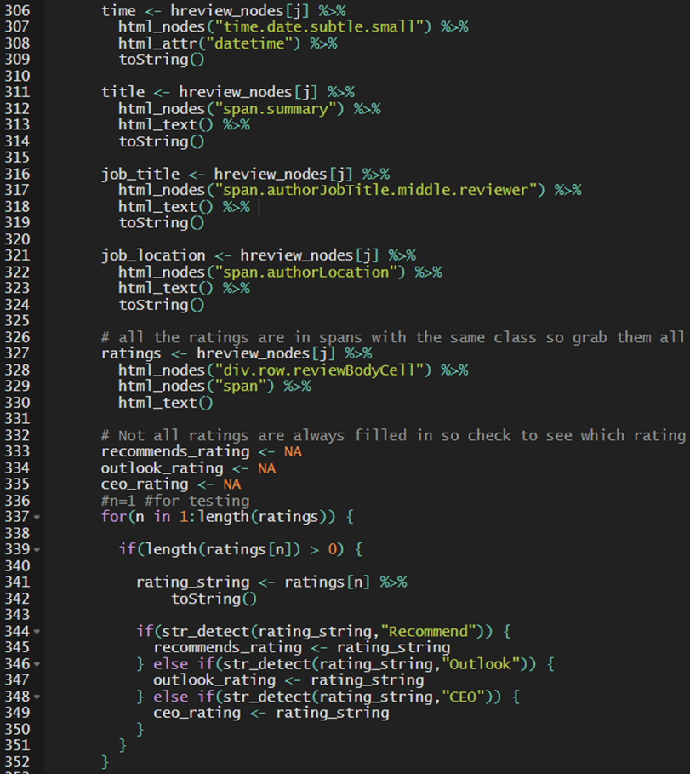
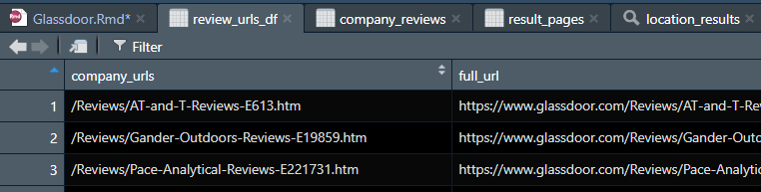
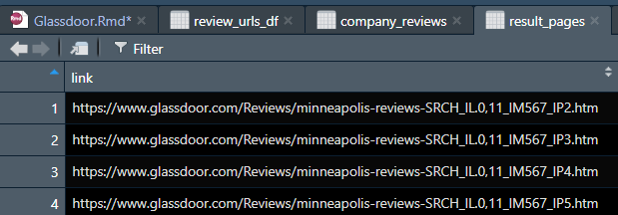
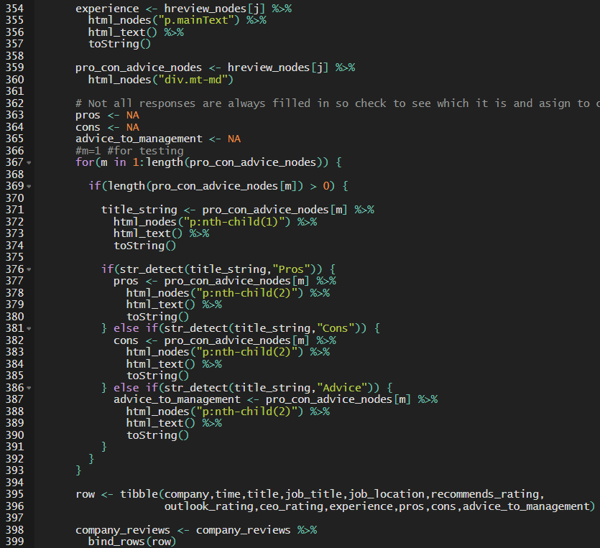
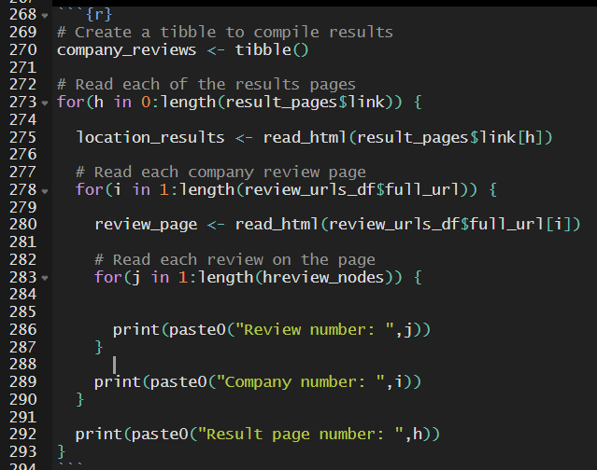
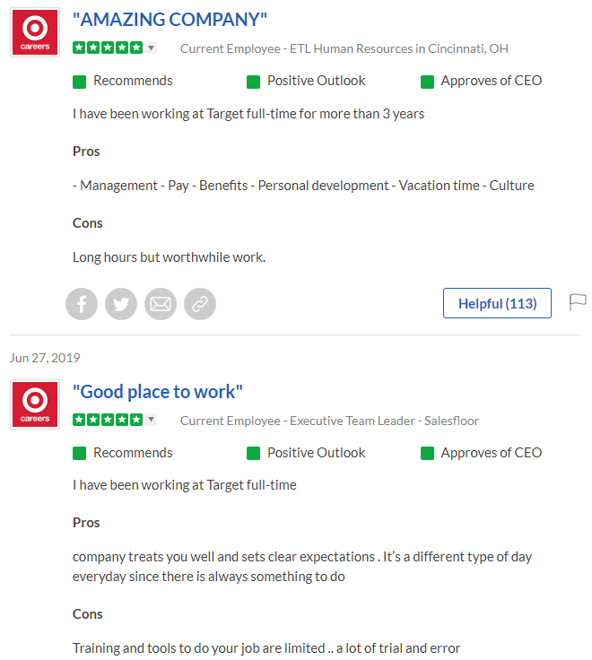
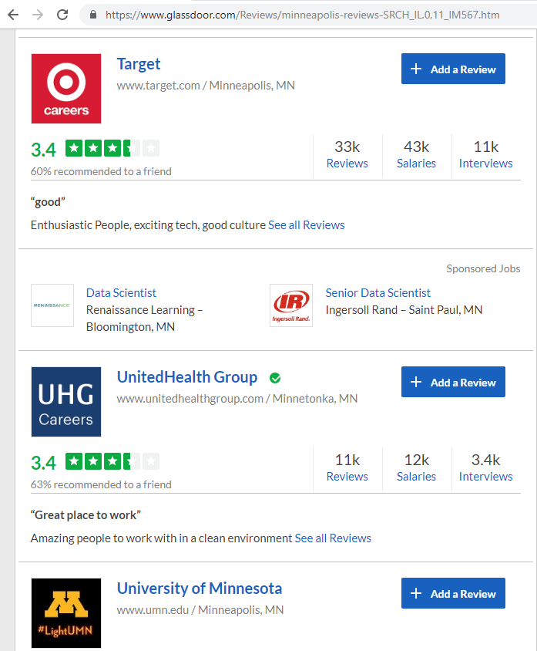
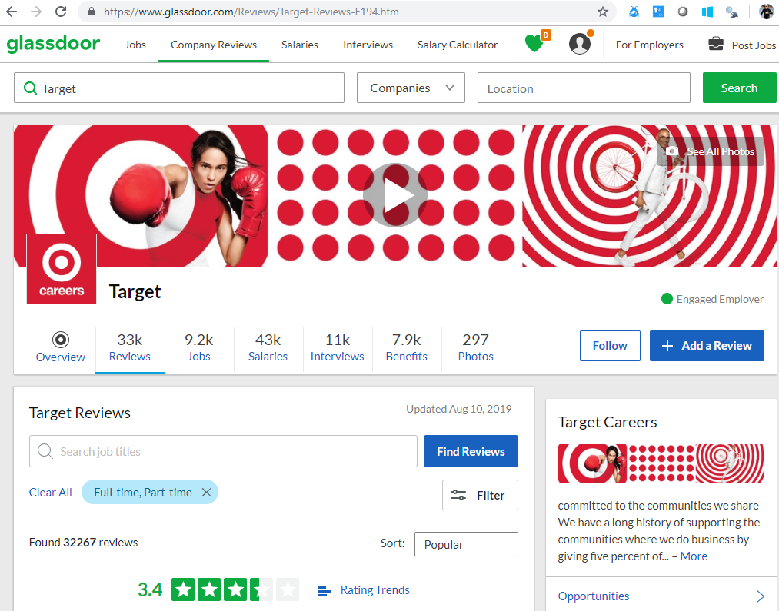
4. Compile code to loop through and pull all results

Slide 28
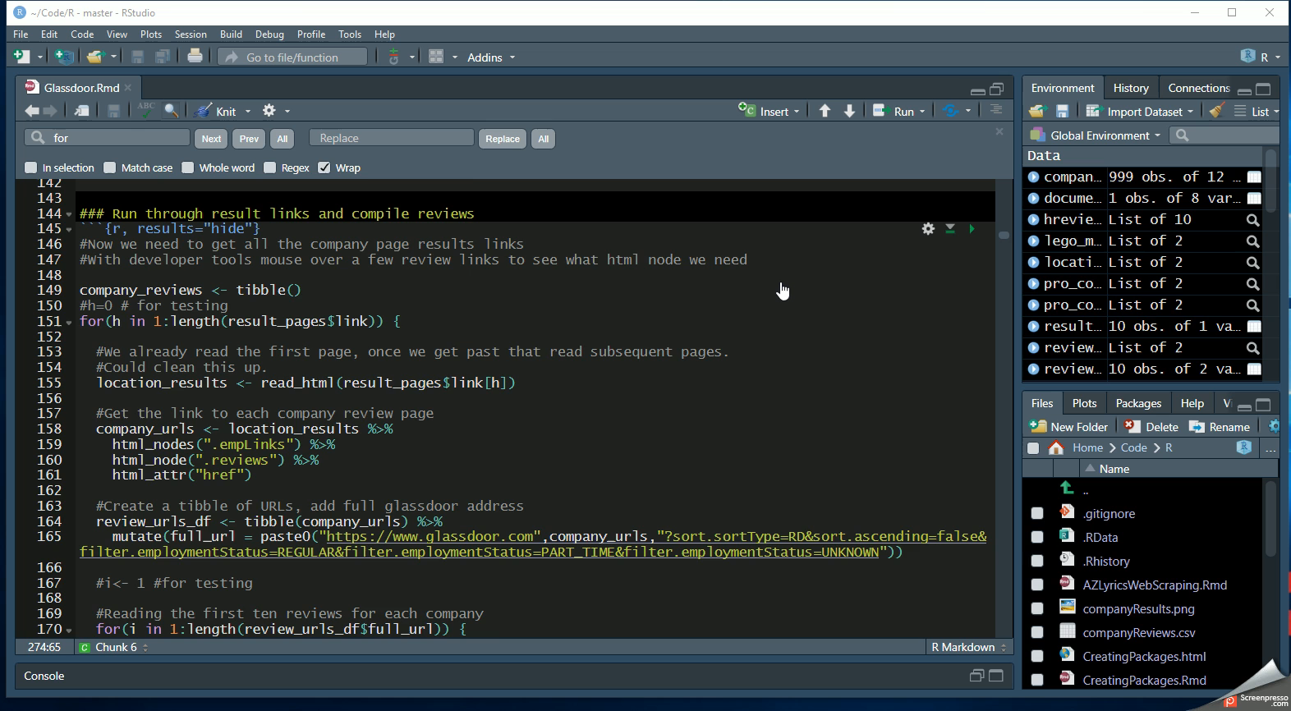
4. Compile code to loop through and pull all results (cont.)

Slide 29
Challenges
Use purrr instead of loops
Currently only pull the first ten review results because you need to authenticate to view further pages. Can you authenticate and pull next pages?
Pull out the stars from the reviews

Slide 30
Code samples
Slides and code available on noRth conference github.
Another example with scraping lyrics and creating a gif word cloud:
https://github.com/hlendway/R - “AZLyricsWebScraping.Rmd”

